Slide 1
Haptic painting on a tablet
Bachelor defense
Naomi B. M. Knudsen & Sara Selman
DIKU 28/06/2024

Slide 2
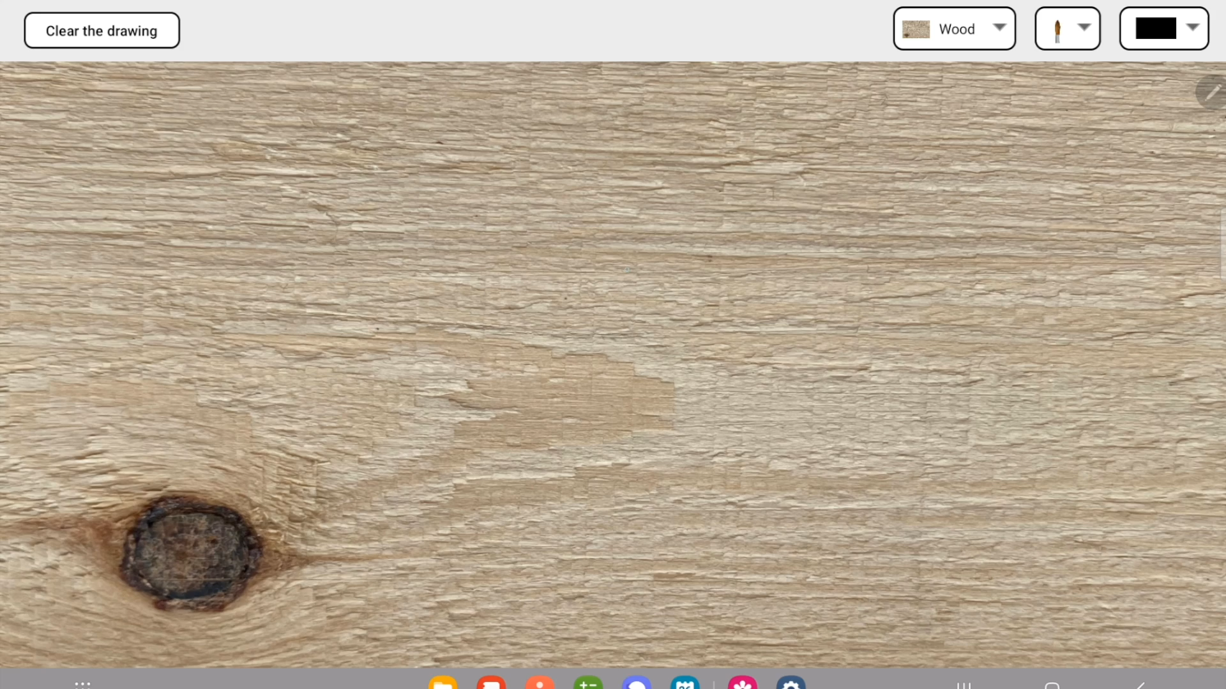
Video of set-up and use of app
Notes:
15-30 seconds, person on left, screen capture on right
Sara:
Before presenting our project, we want to show a demo of how it works, here we have a video of a user using the application, and also a screen redcording of the screen.
The video starts by showing only the auditory feedback, and then we switch to haptic feedback.

Slide 3

Introduction & motivation
Education
Time
Bettering digital art
Visual + auditory + haptic feedback
Notes:
Sara: Our project is about creating a haptic Painting app, which we found could be helpful for different reasons:
Naomi: Education and time – Digital painting can be a tool in learning to paint such as painting techniques among others. It also make painting possible without having the drying wait time of real-life painting.
Sara: Since digital art is becoming more and more popular, we want to make sure that it is just as satisfying as the real deal, by adding realsitic components as haptic and auditory feedback.
So our solution was to create a painting app containing both Visual + audiotory + haptic feedback

Slide 4
Haptic painting project
App
Hardware
Feedback
User study
Haptic
Auditory
Realism
Usability
Rendering
Notes:
Sara:
Our project can be split up in four parts
The app, the hardware, the feedback and the user studies, Which then branch out to the different metods or components.
We look at the app first

Slide 5
Design
Interface:
List of classes:
MainActivity
DrawingView
PlayHaptics
PlayMusic
ControlFeedback
CustomAdapter
CustomBrushAdapter
CustomColorAdapter
Notes:
Nae
Like the video showed, the interface of the app contains a clear button that clears the painting on the textured background, and three drop down menus, which can be used to change the background, brush and brush color.
In order to create this interface, we created 8 classes which can be seen here.

Slide 6
Haptic painting project
App
Hardware
Feedback
User study
Haptic
Auditory
Realism
Usability
Rendering
Notes:
Nae
Besides the software part of the project, that we just talked about, there is also some hardware necessary to create the haptic experience

Slide 7
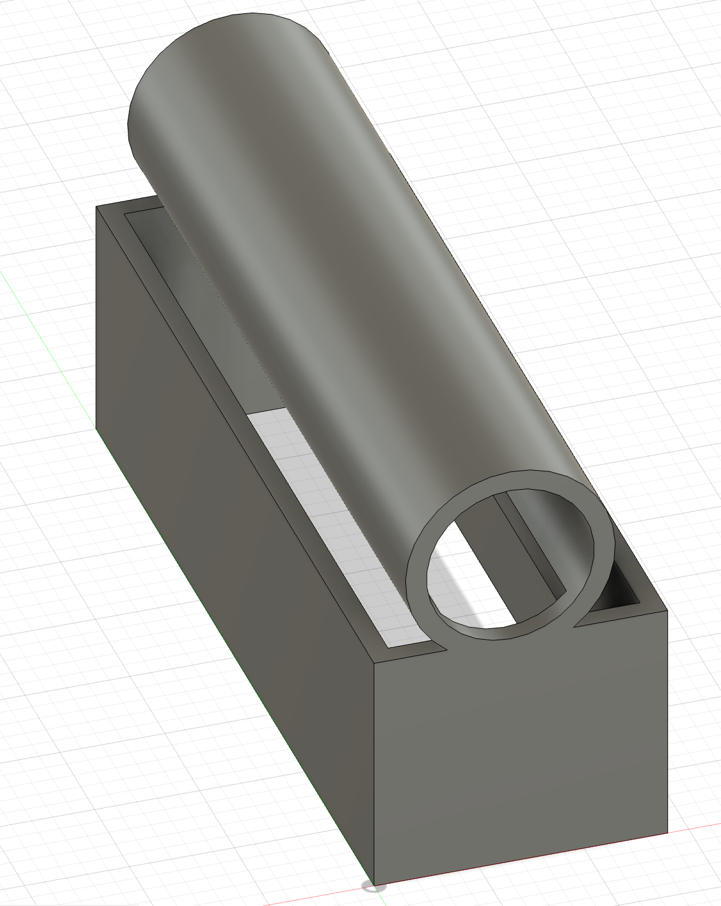
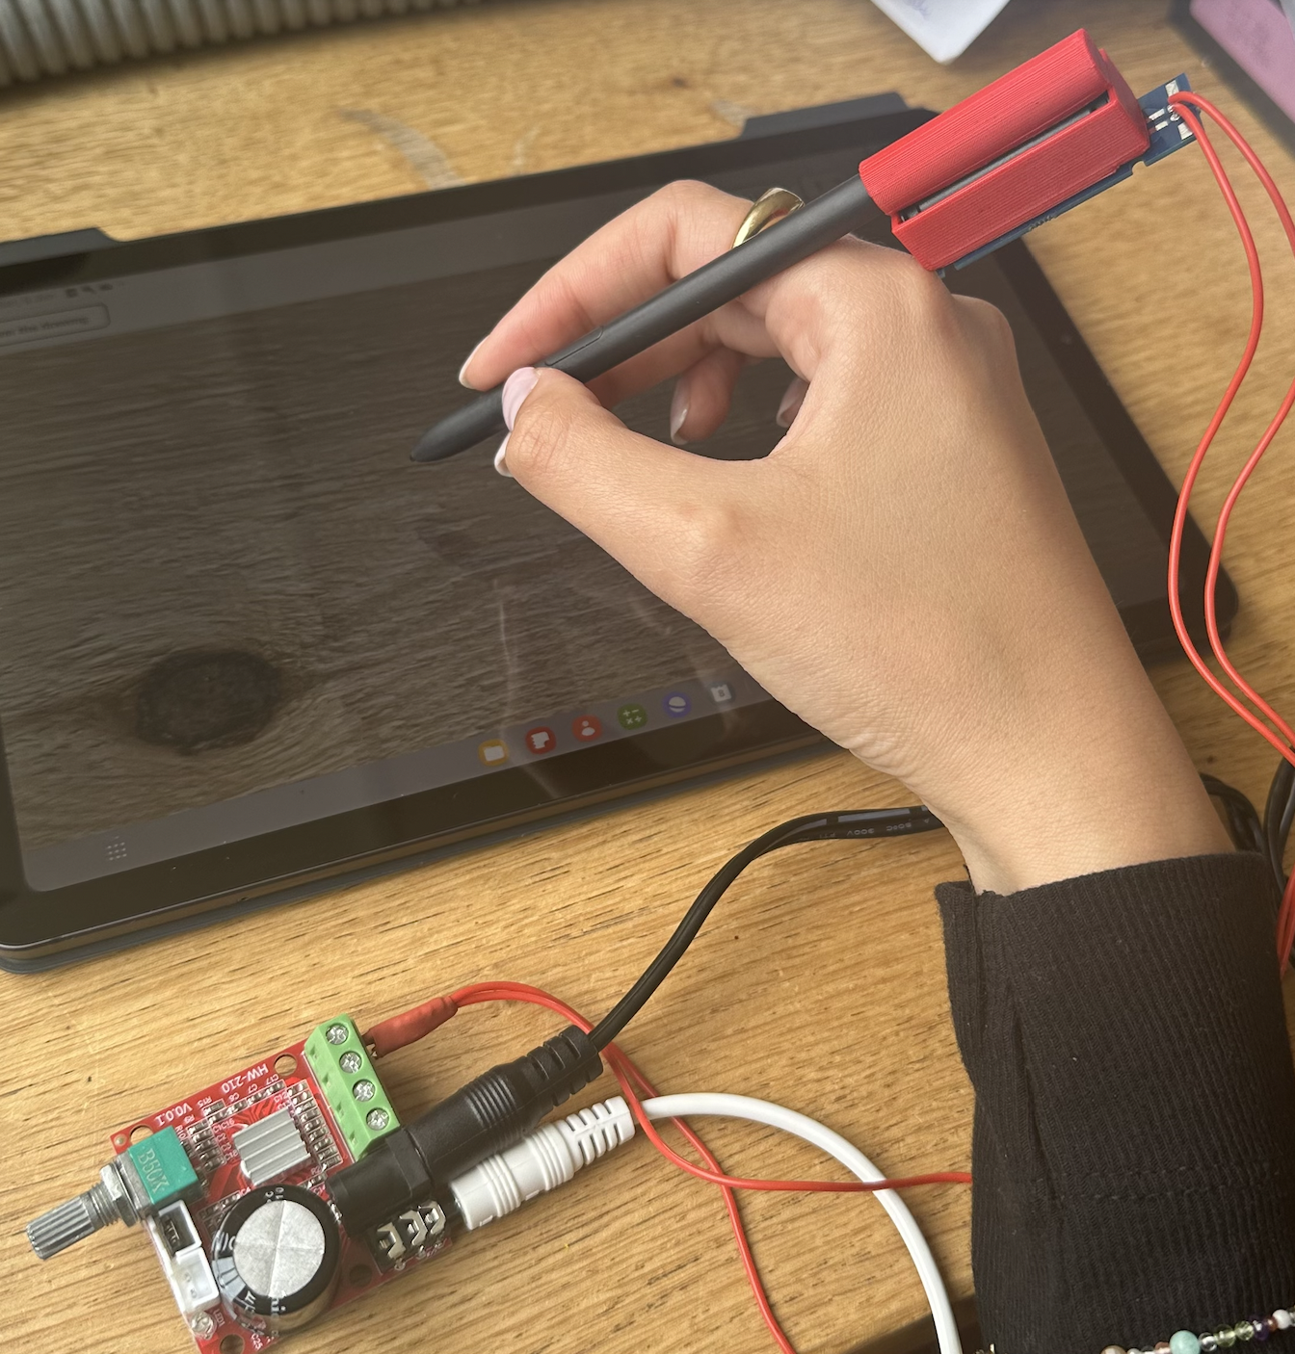
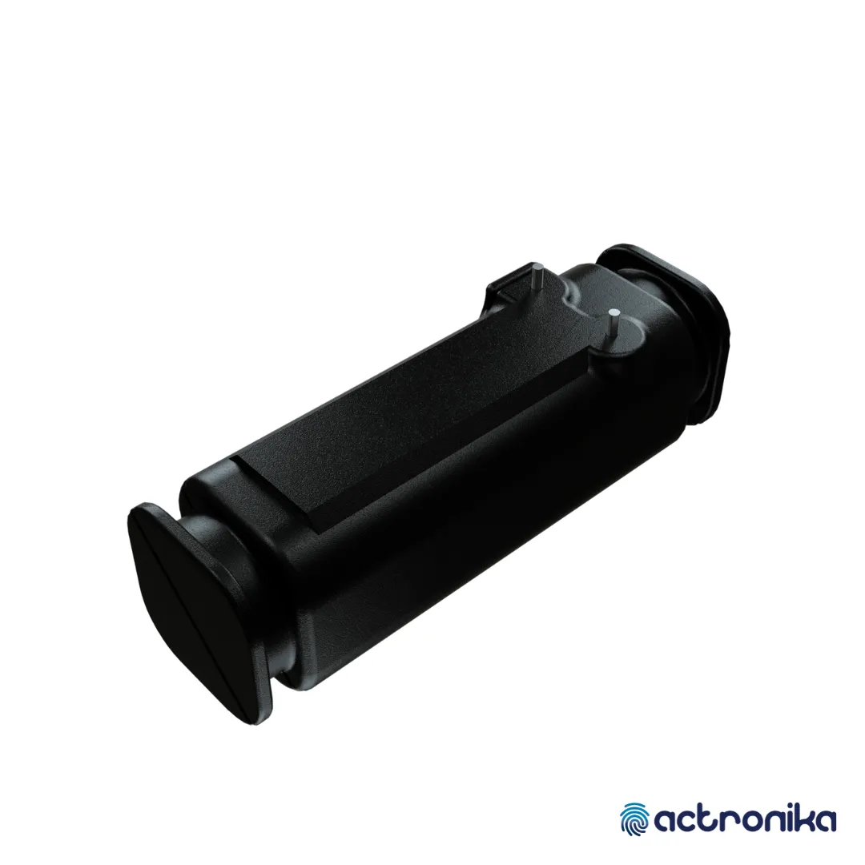
Methods – Hardware
Voice coil actuator​
Larger frequency range​
More control
3D holder​
Fusion and Cura
Complete setup
VCA picture source: https://tactilelabs.com/products/hapcoil-one/
Notes:
Sara:
To look at the components needed to create the haptic stylus, we needed:
An External actuator, we needed this since the VCA has a larger frequency range, than a tablets internal vibrator and provides us with more control of the frequency and amplitude.
Then we created a 3D holder for the VCA, such that the vca would fit nicely on the pen. This was done in Fusion and then Cura to print.
The complete setup can be seen here, where the actuator is connected to the amplifier, and the amplifier is connected to the tablet .

Slide 8
Haptic painting project
App
Hardware
Feedback
User study
Haptic
Auditory
Realism
Usability
Rendering
Notes:
Sara:
Now looking at the feedback, we have both Haptic and Auditory, but we start by looking at the feedback methods overall.

Slide 9
Background – Haptic Feedback
Sense of touch
The two most common methods
Different in their approach
Predefined equations with tunable parameters
Pure sine wave
Amplitude, frequency and sample rate
Parametric method
Data-driven method
Collecting data
Acceleration
and velocity
Haptic feedback
Sensorized tool
Notes:
Nae: General – Haptic feedback provides simulation and feedback though sense of touch. The two most common methods for creating haptic feedback is parametric haptics and data -driven haptics, although they are different in their approach. We used parametric haptics in the beginning but ended up using data-driven haptics.
Nae: Parametric – In the parametric method, the haptics is created through predefined equations that have tunable parameters. A simple approach for texture simulations is creating a pure sine wave, using the tunable parameters amplitude, frequency and sample rate.
Sara:
In the data-driven method, the haptics is created by utilizing a sensorized tool to collect our data, and from that data we can get the acceleration and velocity to create the haptic feedback.

Slide 10
Haptic painting project
App
Hardware
Feedback
User study
Haptic
Auditory
Realism
Usability
Rendering
Notes:
Sara
We created Haptic feedback, by using the data-driven method.

Slide 11
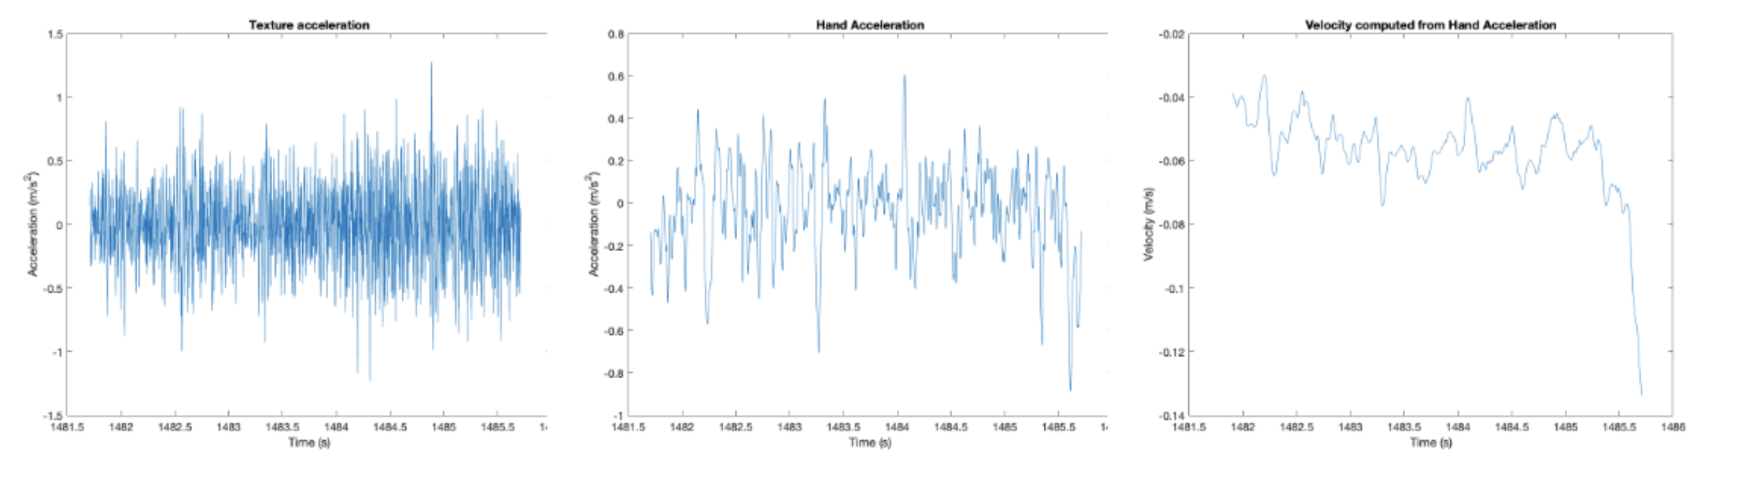
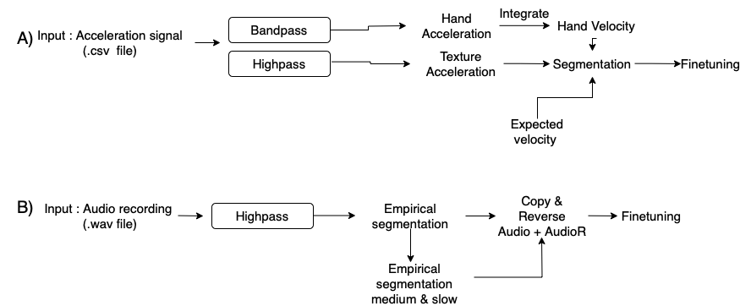
Modelling – Haptic Feedback
Haptic feedback pipeline
Pre-processing
Data segmentation
Fine tuning
Notes:
Sara
The haptic pipeline is split into 3 parts, a pre-processing part, data segmentation and then finetuning.
In the pre-processing part, we used the data collected from the senorized tool (our accelerarion signal, which we then applied a bandpass filter to, which gave us the hand acceleration, that we then integrated to get the hand velocity.
We also applied a highpass filter, which gave us the Texture acceleration.
This can be be seen in the graphs.
Then we have our data segmentation part, here we calculated the expected velocity using the formula for expected velocity. We used the expected values, to find data points that fit a given interval of the expected velocity.
We then saved these datapoints from the hand velocity, and then found the texture acceleration data at these indexes and repeated that until we had 80 samples.
From these 80 samples, we then created a .wav file that was be played as the haptics.
For the finetuning part, we had to manually adjust the gain so it felt as close to the real feeling as possible.

Slide 12
Haptic painting project
App
Hardware
Feedback
User study
Haptic
Auditory
Realism
Usability
Rendering
Notes:
Nae
Besides the haptic feedback, we also created auditory feedback.

Slide 13
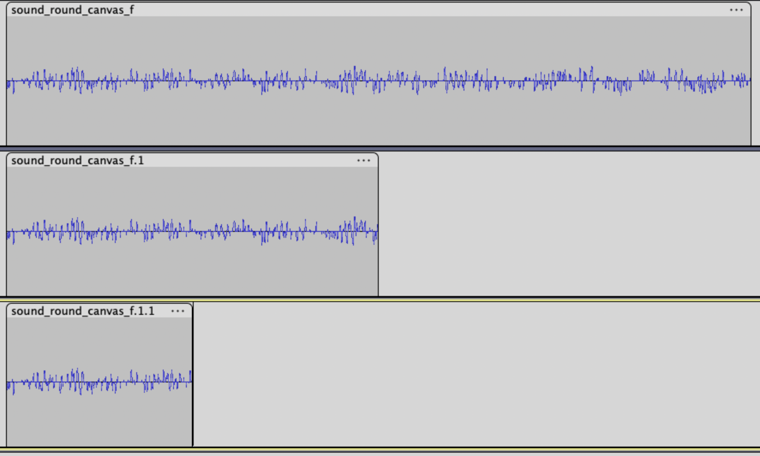
Modelling – Auditory Feedback
Auditory feedback pipeline
Pre-processing
Empirical segmentation
Fine tuning
Continuity and realism
100 ms
50 ms
25 ms
Notes:
Nae
Pre-processing: The auditory feedback pipeline has a pre-processing part, where we applied a high-pass filter to the audio files, we had recorded during data collection.
Empirical segmentation: In the empirical segmentation part, we empirically selected the best 100 ms of the filtered audio file of the fast hand velocity. We then did empirical segmentation of this sound snippet and chose 50 ms for the medium hand velocity sound and 25ms for the slow hand velocity sound.
Fine tuning: In the fine-tuning part, we copied and reversed the audio snippet selected in the empirical segmentation. We then used the ratio between the fast and medium expected velocity as well as the fast and the slow expected velocity to slow down the snippet for respectively the medium and slow hand velocity sound.
Lastly, we adjusted the volume of the sound.
Maybe: The fine tuning part was necessary for the continuity and realism of the sound to be the best.

Slide 14
Haptic painting project
App
Hardware
Feedback
User study
Haptic
Auditory
Realism
Usability
Rendering
Notes:
Sara:
We'll now show how the rendering on the feedback in the app works.

Slide 15
Modelling – Rendering
Input: Touch placement
Show paint
Brush & color
Rendering pipeline
Visual rendering pipeline
Notes:
Nae
The rendering begins once the user touches the tablet’s screen. The loading of the model and the models based on speed happens simultaneously in the app. Based on the chosen canvas and brush and the hand velocity an audio file matching these criteria is played. This pipeline is repeated every 20 ms in the app as long as the user still touches the screen.

Slide 16
Haptic painting project
App
Hardware
Feedback
User study
Haptic
Auditory
Realism
Usability
Rendering
Notes:
Naomi: We will now talk about the results we found from the user studies

Slide 17
User studies - Realism study
The study
Texture comparisons
Brush comparisons
Key takeaways
3/4 textures
Wood and silk fine tuning
Thin and flat brush fine tuning
Haptics too low
Notes:
Example of worst or best
Put R/R and V/V in extra slides
Naomi
The study: In the realism study we asked the participant to compare real textures with the virtual textured backgrounds we had created using haptic feedback using the same real and virtual brush. We also asked the participants to compare the brush types using the same real and virtual canvas.
Key takeaways: *point* From the study we learned that the virtual wood and silk texture should be fine tuned. We also learned that the virtual thin and flat brush should be fine tuned. Overall the feedback was that the haptics were too low, and the older participants couldn’t feel the haptics without touching the actiuator directly.

Slide 18
User studies - Realism study
Textured backgrounds
Real vs. Real
Virtual vs. Virtual
Virtual vs. Real
Brush
Virtual vs. Real
Key takeaways
Wood and silk fine tuning
Thin and flat brush fine tuning
Haptics too low
Notes:
Example of worst or
Put R/R and V/V in extra slides

Slide 19
Haptic painting project
App
Hardware
Feedback
User study
Haptic
Auditory
Realism
Usability
Rendering
Notes:
Sara:
We also did a usability study.

Slide 20
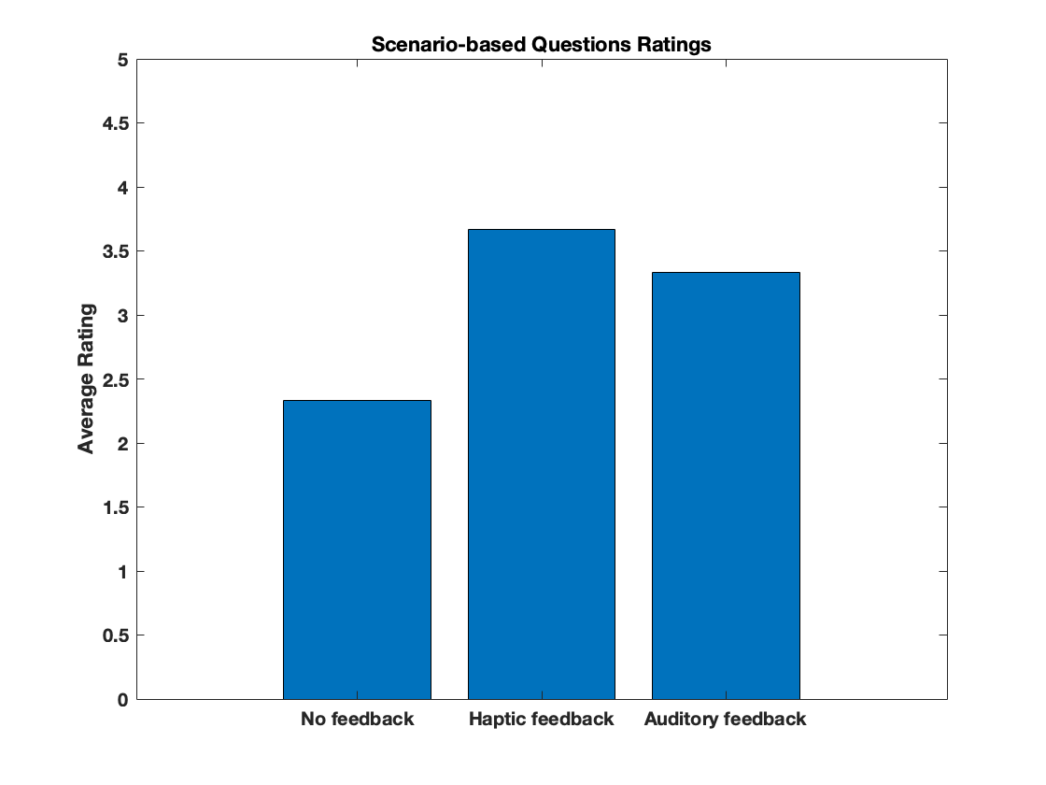
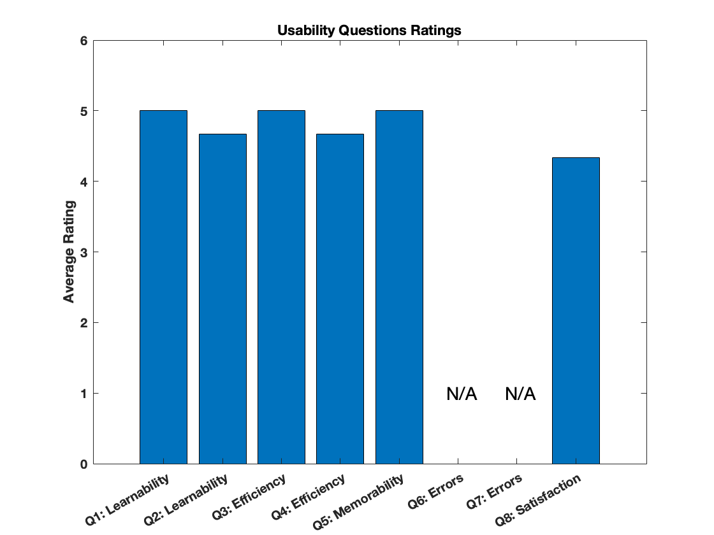
User study - Usability study
Scenario-based
No feedback
Haptic feedback
Auditory feedback
Usability questions
Nielsen’s five usability attributes
Key takeaways
Overall rating of 4.7 (Usability)
Haptics too low
Notes:
Sara:
Our usabiliy study was split into two parts, Scenario-Based questions and usability questions.
For the Scenario-Based questions, the participants were asked questions about the different Scenarios, no feedback (so visual only), only haptic feedback and only audiotory feedback.
Here it was shown that the participants found that the engagement was the highest for the haptic feedback scenerio, and lowest for the no feedback.
For the usability questions we used Nielsen's five usability attibutes, to evaluate how the great the usability of the app is.
The key takeaways, were that we in the usability study had an overall rating og 4.7, which indicates that the app follows the usability attributes and provides a great expereince.
A comment that we recived during the usability study, was that the haptics were too low, and the partricipants wished for a more exaggerated experience

Slide 21
User study - Usability study
Scenario 1: Without any haptic or auditory feedback 1. How engaging did you find the painting experience?
Scenario 2: With only haptic feedback 1. How much did the haptic feedback enhance your painting experience?
Scenario 3: With only auditory feedback 1. How much did the auditory feedback enhance your painting experience?
Notes:
Extra slides of questions

Slide 22
User study - Usability study
Learnability: 1. How easy was it to understand how to use the application for the first time? 2. Was the application navigation as expected?
Efficiency: 3. How quickly were you able to efficiently complete the task? 4. Do you think that the application allows you to complete the task efficiently?
Memorability: 5. If you were to complete the same task again after a long time, do you think you would be able to remember how to use it?
Errors: 6. Did you encounter any difficulties or errors when learning how to use the application? 7. If you encountered any errors during the task, how easily were you able you recover from them?
Satisfaction: 8. How satisfied are you with the overall experience?
Notes:
Extra slides of questions

Slide 23
Limitations
Bugs
Simultaneous haptic and auditory feedback
Single output thread
Best suited class
Notes:
Sara : When conducting our user studies, we discovered some limitations. We found a bug in the implementation. If the user made several clicks within one second , the haptic feedback would continue to play or stop playing at all, even if the user had lifted their stylus.
Naomi: Simultaneous: Besides the bug, we also encountered both hardware and software limitations. The hardware limitations is that most android devices use single output thread for the audio jack and the internal speakers, which only play one sound through the audio jack and internal speaker at the same time. Ans so you can't play a haptics feedback fole and auditory feedback file at the same time.
The software limitation is that the class that is best suited to play the auditory feedback doesn’t have a way of routing to specific outputs, such as a Bluetooth headset. Which meant that we couldn't control the where output of the auditory feedback

Slide 24
Conclusion
Painting app
Haptic feedback
User studies
Feeling of textured surfaces
Enhance experience
Notes:
Naomi:
Despite limitations: However, despite these limitations we were able to achieve our goal and create a painting app which could give haptic feedback when painting.
User studies: Through both studies we showed that the haptic feedback could replicate the feeling of textured surfaces, and that this enhanced the painting experience, and made it feel more realistic.

Slide 25
Future work
Simultaneous haptic and auditory feedback
Fine tuning again
Better visual feedback
Notes:
Sara:
Future work could focus on implementing the haptic and audiotory feedback to play simultaneously, since it was shown that the addiction of the feedbacks enhanced the experience.
It was also clear in both our user test, that the haptics should be finetuned, both sp its more exagerated and so it is more like itrs real counterpart .
Another comment made by participants during the study, was that the visual feedback of the app was very underwhelming. If we want this app to be usefull, and closley simulate real life painting, future work should focus on also implemetnting better visual feedback.

Slide 26
Thank you
What we learned:
3D printing
Using Arduino with accelerometer
Coding in Java
Feedback modelling
Conducting user studies

Slide 27
Questions & comments?

Slide 28
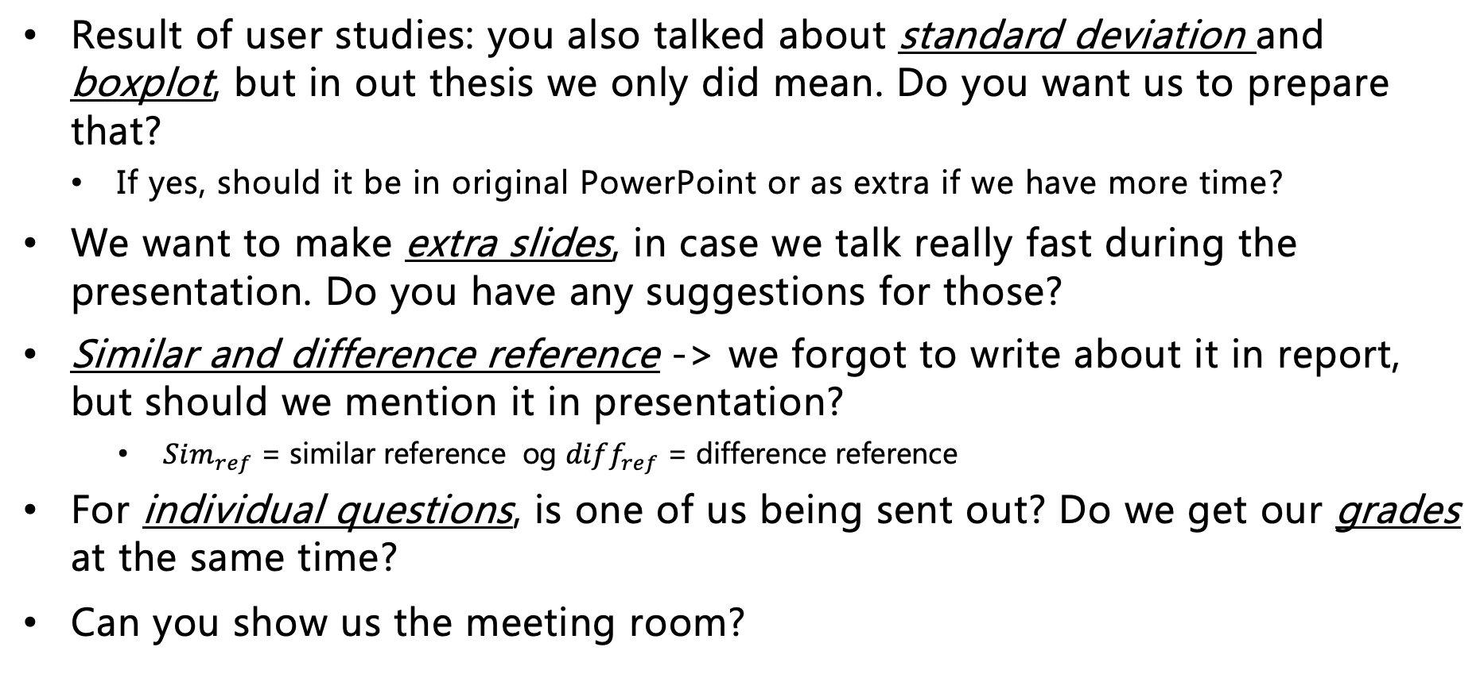
Questions for Waseem
Result of user studies: you also talked about standard deviation and boxplot, but in out thesis we only did mean. Do you want us to prepare that?
If yes, should it be in original PowerPoint or as extra if we have more time?
We want to make extra slides, in case we talk really fast during the presentation. Do you have any suggestions for those?
Similar and difference reference -> we forgot to write about it in report, but should we mention it in presentation?
$Sim_{ref}$ = similar reference og $diff_{ref}$ = difference reference
For individual questions, is one of us being sent out? Do we get our grades at the same time?
Can you show us the meeting room?
Notes:
first: no
Extra slides: details, pipeline
less time on results, more on background
Sim_ref in extra slide

